Slide 1


Citation Networks Evolution Using Dynamic Network Embeddings
Shay Bistrizky
Avishay Bar
Students
316165984
206622086
Dr. Renata Avros
Supervisors
Prof. Zeev (Vladimir) Volkovich

Slide 2
Project Overview
In this project, we aim to classify and analyse citation behaviours within dynamic citation networks. By understanding these patterns, we can gain insights into how knowledge propagates, how influential research emerges, and how academic discourse evolves over time.
Perform
Analyze
Perform citation classification for deeper scholarly insights
Develop
Analyze dynamic network embeddings
Develop a model for embedding dynamic citation networks.
The aim is to identify citations within the dynamic networks that exhibit classification-relevant behaviours and develop a validated framework to confirm these observations. This provides a systematic approach to understanding and verifying citation dynamics in evolving scholarly landscapes.

Slide 3
Road Map
Introduction
1
Research Objectives
2
Background
3
Approach
4
Model Flowchart
5
Conclusion
6

Slide 4
Road Map
Introduction
1
Research Objectives
2
Background
3
Approach
4
Model Flowchart
5
Conclusion
6

Slide 5

Introduction
Significance of Highly Cited Articles
Dynamic Networks and Embeddings
Shaping research priorities, fostering collaboration, and driving innovation.
Use embeddings to track changes, reveal trends, and identify key works.
Static Analysis Limitations
Dynamic Citation Analysis
Limitations in capturing temporal changes, identifying trends, and predicting dynamics.
Classify citation articles through embedding analysis.

Slide 6
Citation Dynamic Network Nature
Irreversibility of Edges
Node Longevity
Citations are permanent and unidirectional, highlighting the enduring impact of foundational works.
Articles remain relevant for years, anchoring the evolving research landscape.
Hierarchical Structure of Influence
Citation Burstiness
Citation networks flow hierarchically, with older works as "roots" and newer works building on them.
Citations surge with trends, paradigm shifts, or discoveries, highlighting research focus shifts.

Slide 7
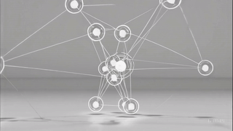

Slide 8
Road Map
Introduction
1
Research Objectives
2
Background
3
Approach
4
Model Flowchart
5
Conclusion
6

Slide 9
Project Objectives
The approach focuses on three interconnected objectives providing a comprehensive understanding of citation networks:
Dynamic Networks Evolution
Identify Patterns
Examine structure and evolution over time using a dynamic embedding approach.
Develop Scalable Models
Analyze node classifications within the citation dynamic network and be able to validate the results.
Create an efficient embedding model for large-scale analysis.

Slide 10
Road Map
Introduction
1
Research Objectives
2
Background
3
Approach
4
Model Flowchart
5
Conclusion
6

Slide 11
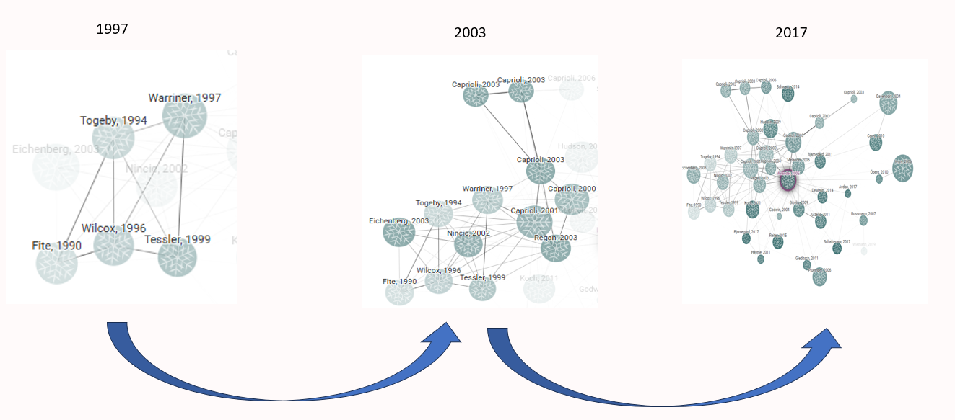
Dynamic Networks
1
Static Networks
2
Dynamic Networks
3
Temporal Changes
Static networks capture connections at a single point in time, lacking the evolution of relationships.
Dynamic networks capture evolving connections over time, showing how relationships change.
Key factors are node proximity and temporal continuity, showing closeness and consistent representation over time.

Slide 12
Dynamic Bernoulli Networks Embeddings
Dynamic Bernoulli embeddings are a novel approach in dynamic network analysis aiming to expose the proximity and temporal continuity of nodes in a dynamic network. Dynamic Bernoulli embeddings are based on random walks to generate sequences of nodes.
Random Walk
1
Track the sequential context of nodes within the dynamic network.
Calculating Loss using Negative Sampling
2
Calculate loss elements and utilizing negative sampling.
3
Loss Optimization
Minimize the loss function using the SGD algorithm.
Context Update
4
Updating context vector to each node in the temporal graph.

Slide 13
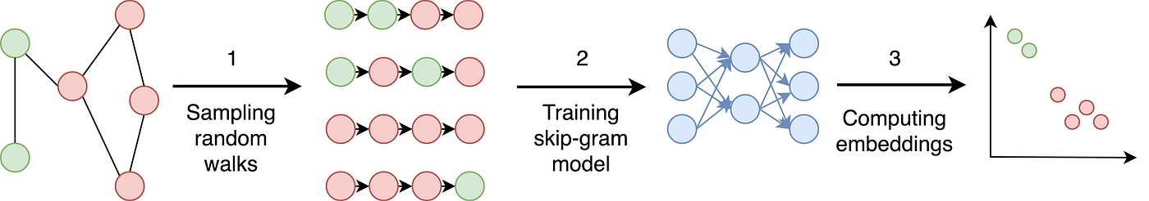
Random Walks for Network Exploration
What is a Random Walk?
Key Advantages
A random walk is a stochastic process that generates a path through a graph. At each step, the next node is chosen randomly from the current node's neighbors.
Enabling efficient sampling of large networks, especially when global computations are impractical or computationally expensive.
Random Walk vs. Probability
Each step to a neighbouring node is determined by probabilistic transitions. These probabilistic movements capture the co-occurrence frequencies of nodes, which are then leveraged to learn robust low-dimensional embeddings.

Slide 14
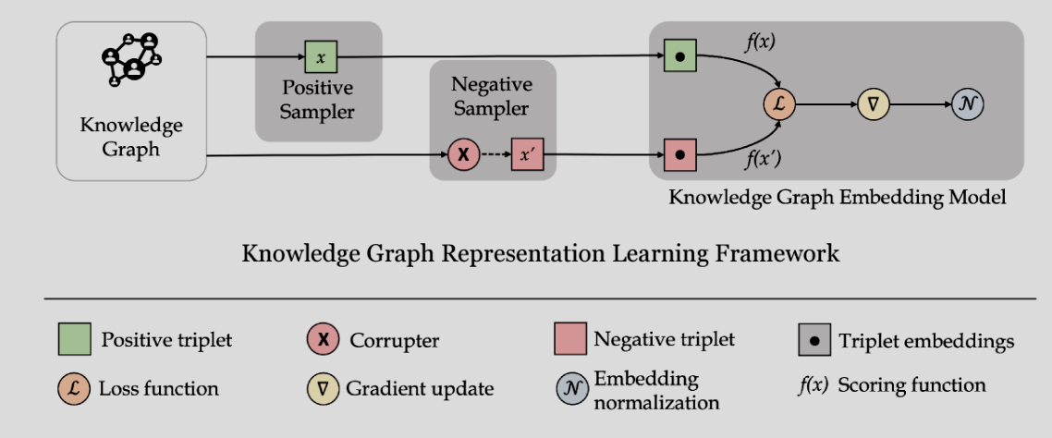

Learning Graphs By Sampling
Negative sampling is a pivotal technique for training embeddings in dynamic networks, as it helps algorithms distinguish real connections from noise at each time step. By selectively sampling non-existent edges, it reduces computational overhead and enhances the model’s ability to capture evolving relationships.
Citation
Graph
Citation Graph Embedding Model
$$ℒ =ℒ_{α}+ℒ_{pos}+ℒ_{neg}+ℒ_{y}$$
Citation Graph Representation Learning Framework

Slide 15
Road Map
Introduction
1
Research Objectives
2
Background
3
Approach
4
Model Flowchart
5
Conclusion
6

Slide 16


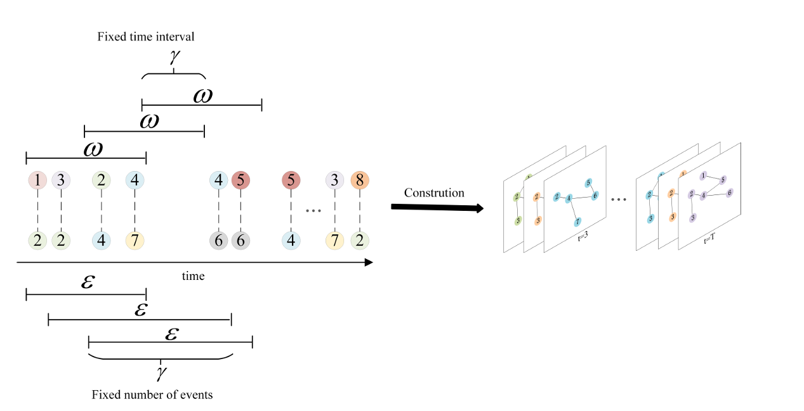
Approach
In a dynamic citation network, each article is represented as a node, and a directed edge signifies a citing. Over time, new papers and citation links are added, capturing the evolving nature of academic influence and knowledge transfer. Two strategies for constructing the dynamic citation network :
Fixed Time Interval
Fixed Event Count
Create snapshots at regular time intervals, like monthly or yearly.
Construct networks by dividing them into snapshots, each containing a fixed number of citation events, ensuring uniform density while remaining independent of time intervals.

Slide 17

Node Classification
Emerging Nodes
Nodes with recently increasing citations.
Rising Stars (Sleeping Beauty)
Emerging nodes with significant growth.
Steady Nodes
Nodes with consistent citation activity.
Falling Stars
Nodes with declining citation activity.

Slide 18
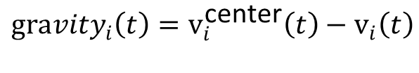
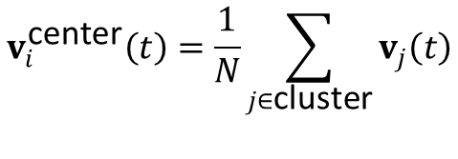
Classification Evaluation
Connectivity in dynamic networks is the ability to maintain communication despite changing topology.
The centroid in dynamic networks minimizes total distance to all nodes as topology changes.
Emerging Nodes
Steady Nodes
Rapid increase in connectivity
Steady connectivity over time
Rising Stars
Falling Stars
High gravity to centroid
Low gravity to centroid
$$v_{i}^{\text{center}}\left(t\right)=\frac{1}{N}\sum_{j∈\text{cluster}}{v_{j}\left(t\right)}$$
$$Δv_{i}=∥v_{i}\left(t+Δt\right)−v_{i}\left(t\right)∥$$
$$v_{i}−node embedding vector in graph i \\ N −number of nodes in the cluster$$
$${gravity}_{i}\left(t\right)=v_{i}^{\text{center}}\left(t\right)−v_{i}\left(t\right)$$

Slide 19
Road Map
Introduction
1
Research Objectives
2
Background
3
Approach
4
Model Flowchart
5
Conclusion
6

Slide 20
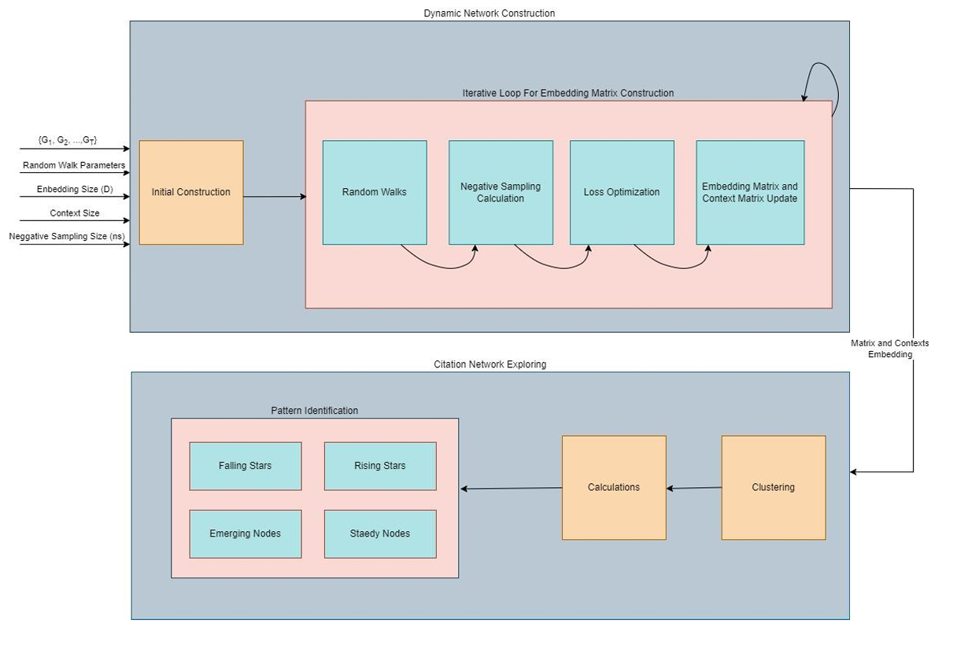
Project Flowchart
Initial Construction
Dynamic Bernoulli Embeddings
Clustering & Calculations
Pattern Identifications

Slide 21
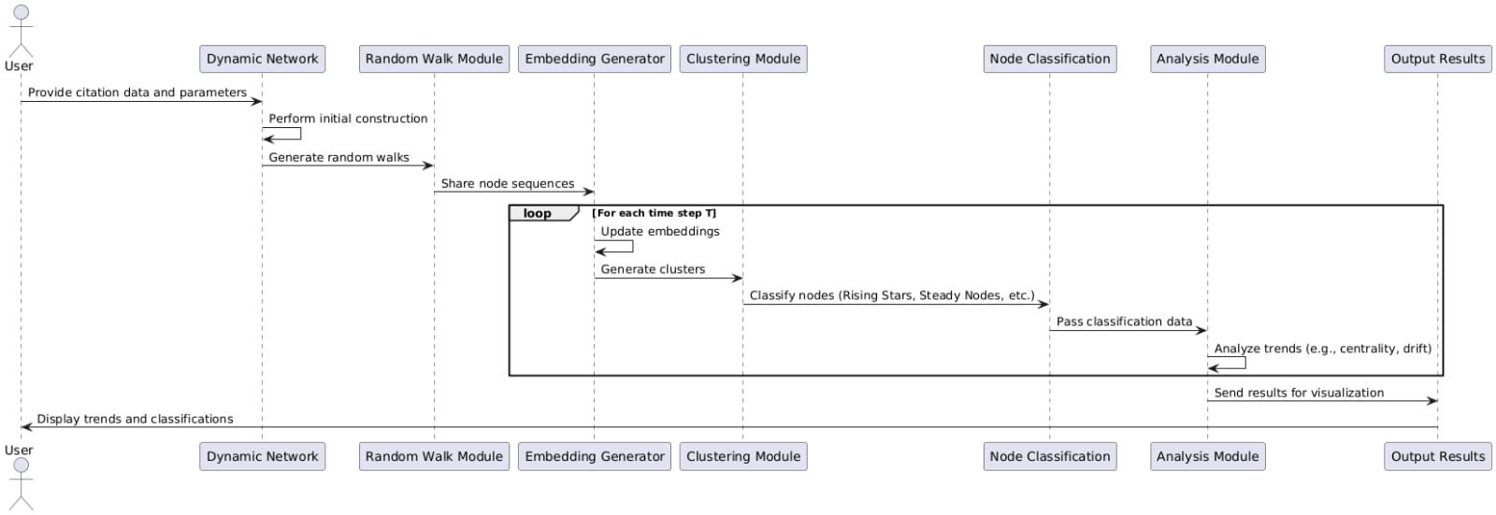
Sequence Diagram

Slide 22
Testing Plan
Unit Under Test | Test Case | Input | Expected Output
Dynamic Network | Network Construction with Fixed Time Intervals | Citation data split into yearly intervals. | Correctly structured networks for each year, with accurate nodes and edges.
 | Network Construction with Fixed Event Counts | Citation data with a specified number of events per snapshot. | Uniformly dense networks with appropriate overlaps.
Random Walk | Random Walks on Static Graphs | A static graph with defined edges. | Correct sequences capturing both local and global structures.
 | Random Walks on Dynamic Graphs | A dynamic graph with changing nodes and edges. | Sequences adapting to graph changes over time.
Embedding Generator | Embeddings for Static Nodes | Nodes with consistent relationships over time. | Stable embeddings with minimal drift.
 | Embeddings for Evolving Nodes | Nodes with rapidly changing connectivity. | Embeddings reflecting the change in proximity and influence.
Calculation and Classification | Classification of Rising Stars | Nodes with increasing centrality and connectivity. | Nodes correctly categorized as Rising Stars.
 | Classification of Falling Stars | Nodes with declining centrality and connectivity. | Nodes correctly categorized as Falling Stars.
 | Classification of Emerging and Steady Nodes | Nodes with new or consistent citation activity. | Accurate classification as Emerging or Steady Nodes.

Slide 23
Road Map
Introduction
1
Research Objectives
2
Background
3
Approach
4
Model Flowchart
5
Conclusion
6

Slide 24



Future Steps
Approach Implementation
Citations Classification
Validation and Testing
Implement the proposed dynamic embedding framework approach and testing on real-world citation data.
Develop an efficient framework for node classification using the implemented approach.
Validate the framework's effectiveness by analyzing diverse citation networks.

Slide 25

Questions

Slide 26


